Slide 1

School of Electronics Engineering (SENSE)
MTech VLSI design
PERFORMANCE OPTIMIZATION OF
EFFICIENT PIPELINED TURBO ENCODER AND DECODER
Presented by:
Guided by:
Abhishek Patnaik (23MVD0049)
Dr. Prachi sharma
Ass0ciate professor grade 1
Sense

Slide 2
Outline of the Project
Turbo Encoder and Decoder are extensively utilized in wireless communication systems.
In 4G and 5G technologies, the turbo codes are used for error correction in networks.
Compared to turbo coding techniques, the polar codes used in the existing systems are implemented using SCD (Successive Cancellation Decoder).
Due to its limited block length it has low decoding complexity and latency.
In Turbo codes, MAP Algorithm and Max-Log-MAP algorithms are used for optimization.
The proposed system uses a serial pipeline structure in turbo codes to minimize the throughput in wireless communication systems which is the biggest advantage of the efficiency of the design.

Slide 3
Introduction
The purpose of a communication system is to transport information from a source to one or more user destinations via a communication channel.
It is mandatory to reduce the data corruption by providing suitable solution to the errors occurred during the communication process.
Forward Error Correction (FEC) is a technique for error control during data transmission, whereby redundant information is added to the original data, which allows the receiver to detect and correct errors without the need to resend the data.

Slide 4
Literature Review
Title,Author,Year
1."Design and analysis of turbo encoder using Xilinx ISE",By Palle Prasanth Kumar; K V Gowreesrinivas; P Samundiswary - in 2016 International Conference on Control, Instrumentation, Communication and Computational Technologies (ICCICCT)
2. "Turbo-Encoder Design for Symbol-Interleaved Parallel Concatenated Trellis-Coded Modulation", by Christina Fragouli, and Richard D. Wesel - in IEEE TRANSACTIONS ON COMMUNICATIONS, VOL. 49, NO. 3, MARCH 2001
Key Findings
This paper provides the design of a Turbo Encoder, which is parallel concatenation of Recursive Systematic Convolutional (RSC) encoders and interleaver to reduce delay.
The Turbo Encoder is designed by Verilog-HDL and Synthesized by Xilinx ISE.
Further its performance is analyzed through evaluation of metrics such as area and delay.
This paper addresses turbo-encoder design for coding with high spectral efficiency using parallel concatenated trellis-coded modulation and symbol interleaving.
Simulation results show that the proposed system employing symbol interleaving can converge at a lower signal-to-noise ratio than previously reported systems.
Contd…

Slide 5
Literature Review
Title,Author,Year
3. "A Novel Turbo Codec Encoding and Decoding Mechanism", by Desai Feroz - in International Research Journal of Engineering and Technology (IRJET) e-ISSN: 2395-0056, Volume: 04 Issue: 10 | Oct -2017
4. "Designing & Analysis of Advanced Turbo Encoder and Decoder", by Pallavi D Hegu, Venkat Ghodke - in International Journal of Applied Research 2015; 1(8): 341-344
Key Findings
This paper describes the novel concept of turbo coding and decoding.
Basic statistical measures such as an Exclusive OR (XOR) and likelihood were reviewed, and these measures were used to describe the error performance of a decoder using two iterations.
In particular, a new approach with two iterations produces the original information signal as output.
The aim of this paper is to check & verify the functionality of Turbo encoder & Turbo decoder using Viterbi algorithm on Xilinx.
Thus, an efficient architecture for turbo encoder & turbo decoder has been implemented using VHDL.
These configurations give better performance and also has the lower computational complexity find most likely sequence of hidden state.

Slide 6
Problem Formulation
Data corruptions are the important issue confronted by the digital communication systems.
It’s essential for the telecommunication industry to reduce the data corruption by providing a suitable solution to the errors occurred in the communication process.

Slide 7
Proposed System
System Design: Develop Turbo encoder and decoder modules based on 3GPP LTE specifications for efficient error correction.
Algorithm Optimization: Use MAP and Max-Log-MAP algorithms to optimize performance and reduce complexity.
Pipeline Structure: Implement a serial pipeline architecture to improve throughput in wireless communication systems.
Simulation and Testing: Utilize software tools like ModelSim and Matlab to simulate, test, and verify the Turbo coding system.

Slide 8
Methodology – Proposed System
Turbo Encoder: A turbo encoder typically consists of two Recursive Convolutional Encoders (RSC) and a pseudorandom interleaver.
The input data is fed into two encoders, producing two separate encoded sequences. One of the encoded sequences is an interleaved version of the data sequence, while the other is a systematic encoded sequence.
The two encoded sequences are typically multiplexed or punctured before being transmitted over the channel.
Contd…

Slide 9
Methodology – Proposed System
Turbo Decoder: A turbo decoder generally uses two SISO (Single-Input Single-Output) decoders, interleavers, and a deinterleaver.
The receiver receives the encoded stream, and the two decoders begin an iterative decoding process.
In each iteration, each decoder analyzes the received data and outputs a probabilistic estimate of each bit's value.
The iterative process continues until the decoders converge on a reliable estimate of the original data.

Slide 10
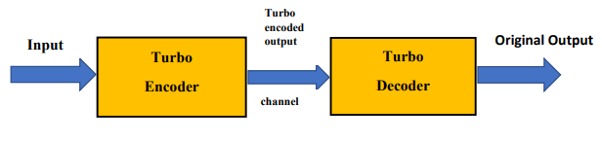
Block Diagram of the Project
Contd…

Slide 11
Block Diagram Description
Turbo Coder consists of Turbo Encoder and Turbo Decoder.
A channel for transmitting data from encoder to decoder.
Turbo encoder produces an encoded output which is input to turbo decoder, that produces a decoded output by removing the errors and reducing the number of iterations by using MAP Algorithm and get back the original output.

Slide 12
What are Turbo Codes?
Turbo codes are a class of high-performance FEC codes known for their ability to achieve coding gains close to the theoretical Shannon limit.
They are used in various applications, including mobile communications (3G/4G/5G), satellite communications, and other scenarios where reliable data transmission is crucial.
Turbo codes employ iterative decoding algorithms, which are essential for their effectiveness.

Slide 13
RECURSIVE SYSTEMATIC CONVOLUTIONAL (RSC) ENCODER
It's constructed by taking a standard, non-recursive, convolutional encoder and adding a feedback loop that feeds one of its encoded outputs back to its input.
This feedback loop is crucial for the performance advantages RSC encoders offer, particularly at high code rates.
Advantage: By implementing this feedback mechanism, RSC encoders leverage the encoder's state and previous outputs to create a more robust encoded stream, leading to improved error performance.

Slide 14
SISO Decoder
A Soft-In Soft-Out (SISO) decoder is a type of decoder that processes data with both soft input and soft output, meaning it considers the reliability of each bit as a value other than just 0 or 1.
Main Features
Soft Input
Soft Output
Iterative Decoding
Algorithms Used

Slide 15
Interleaver
In turbo codes, an interleaver is a component that rearranges the order of data bits, effectively scrambling the input data before it's processed by the second constituent encoder.
This scrambling, or permutation, helps to break up error bursts, making the code more resistant to noisy channels.
Main Features
Scrambling
Improving Performance
Enhancing Code Performance
Burst Error Mitigation
Thus, the interleaver acts as a "randomizer" of data bits, making it more robust to errors and improving the overall performance of the turbo code system.

Slide 16
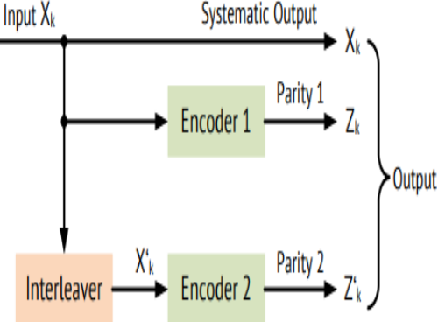
Block Diagram of the Turbo Encoder
Contd…

Slide 17
Encoder - Block Diagram Description
Using pseudorandom interleavers and convolutional encoders (RSC) makes up the turbo encoder.
A third of the workforce is employed by LTE.
Fast code with simultaneous concatenation rate.
Various RSCs work on two unique sets of data. The first is given original data and the second Encoder gets the interleaved data from the first version of the data entered.
Contd…

Slide 18
Encoder - Block Diagram Description
Interleaving is a technique that scrambles the data bits.
The outputs from RSC1 and RSC2 encoders as well as systematic input consists of a 8 bit output.
The output of the turbo encoder, which is a 8 bit output that is composed of the RSC1 and RSC2 encoder outputs as well as systematic input. This will be sent to the Turbo decoder through the channel.

Slide 19
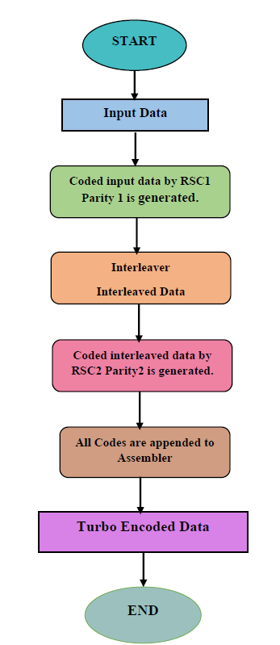
Flow Chart of the Turbo Encoder

Slide 20
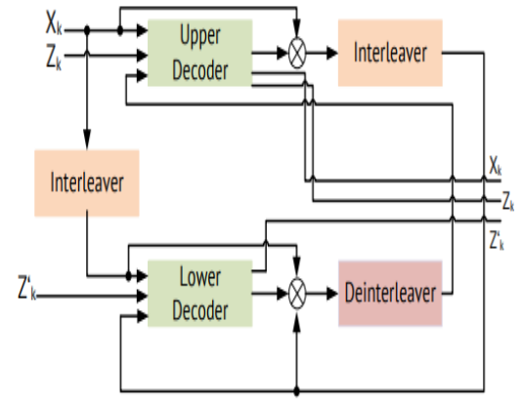
Block Diagram of the Turbo Decoder
Contd…

Slide 21
Decoder - Block Diagram Description
The output of the upper decoder feeds into the lower decoder to form a turbo decoding iteration.
Interleaver and deinterleaver blocks re-order data in this process.
Decoding algorithms - Maximum A Posteriori (MAP), namely LogMAP and MaxLogMAP are used for the decoding process.
Contd…

Slide 22
Decoder - Block Diagram Description
It consists of two decoders which work together.
The operation depends on the soft decision information based on each decoder.
After starting of an operation, Zk is noted as soft decision of one decoder, and is called as extrinsic information. This is used to initialize the other decoder.
The decoded information is moved around the loop until the soft decisions meet the set of values.
Here, the last extrinsic information is used from the first decoder to calculate the values of messages.

Slide 23
Proposed – MAP Algorithm
The decoding process of the turbo codes is based on iterations, performed by the MAP algorithm. This is applied for each constituent code.
MAP algorithm is implemented by the SISO decoder, which is used to check the reliability of the received information.
This will become complex in computing the multiplications and exponential operations, which are needed in the trellis diagram implementation.
For reducing the complexity of the decoder, the two other SISO decoders are developed, in which the complexity of these algorithms will be less as compared to MAP algorithm and those two algorithms are Max Log-MAP and Log-MAP algorithm.
Contd…

Slide 24
Proposed – MAP Algorithm
Log-MAP Algorithm:
The Log-MAP algorithm is an iterative decoding process that estimates the most likely transmitted data bits based on the received signal and a priori probabilities(the likely transmitted data).
It utilizes the log-likelihood ratio (LLR), which is the logarithm of the ratio of probabilities, to represent the confidence in a bit's value.
Max-Log-MAP Algorithm:
This algorithm simplifies Log-MAP by taking the maximum of the log-likelihood ratios instead of calculating the full log-likelihood, reducing the complexity.
The Max-Log-MAP is a practical approximation of the Log-MAP. It performs computations in the logarithmic domain, which simplifies the implementation (especially in hardware) and improves performance.

Slide 25
Maximum A Posteriori (MAP) Decoding Algorithm - Advantages
In essence, the Log-MAP (especially the Max-Log-MAP) algorithm is a key component of Turbo code decoding in LTE, enabling robust and reliable data recovery even in the presence of channel errors.
It's used to recover the original data from the received, possibly corrupted, signal.
This algorithm performs computations in the logarithmic domain, simplifying implementation while maintaining good performance.

Slide 26
Objective of the Project
The main objective of this project is to implement Turbo encoder and decoder.
To implement a serial pipelined architecture inorder to enhance throughput and efficiency in Turbo coding for wireless communication systems.
To correct the errors and retrieve the original message and to reduce the number of iterations required to decode the information bits being transmitted.

Slide 27
Software Used
The verilog code simulation of the proposed system is synthesized using MODELSIM and the achieved wave plots results of the encoder and decoder are cross-verified with the results obtained using MATLAB Software.

Slide 28
Results and Discussions

Slide 29
VERILOG CODING
A pipelined architecture for turbo encoders and decoders in Verilog can significantly improve throughput by allowing multiple stages of the encoding/decoding process to occur concurrently.
This approach involves breaking down the encoder and decoder into smaller, functionally independent stages and then interleaving their execution.
Results often show reduced processing time and increased data rate.

Slide 30
PIPELINED IMPLEMENTATION – VERILOG CODE
Stage Division: The encoder and decoder are divided into smaller modules, each responsible for a specific part of the encoding/decoding process.
Interleaved Execution: The modules are connected in a way that allows them to operate concurrently, processing different stages of the encoding or decoding process is done serially.
Data Buffers: Buffers or queues are used to store intermediate data between pipeline stages, ensuring that data is available when needed.

Slide 31
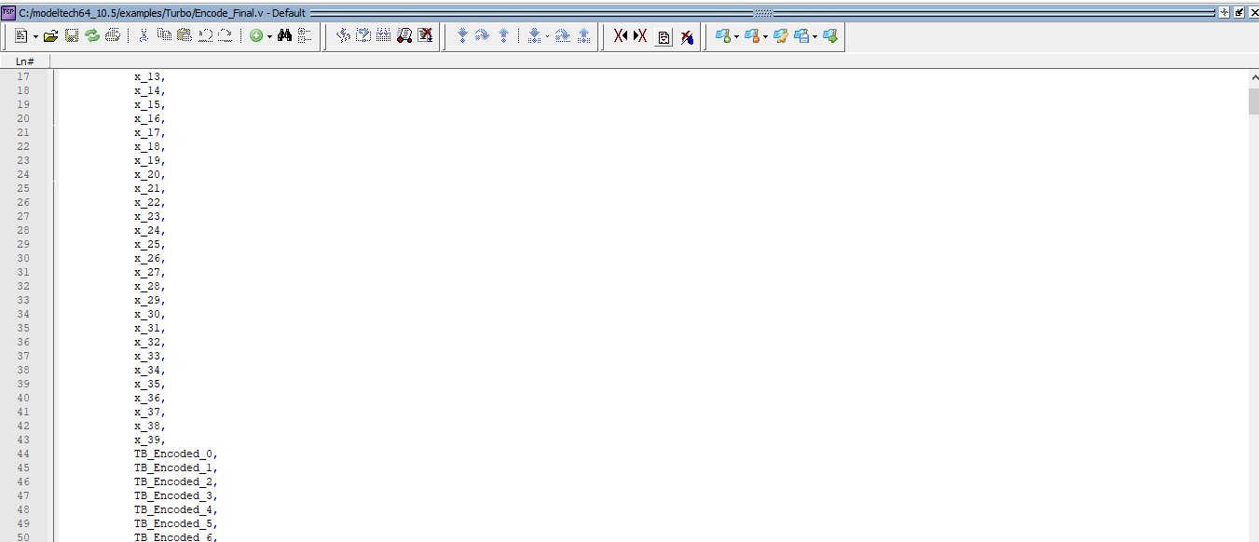
VERILOG CODE - ENCODER
In the turbo encoder side, when the original bits are given as input, where the systematic, upper encoder bit, lower encoded bits are generated.
Contd…

Slide 32
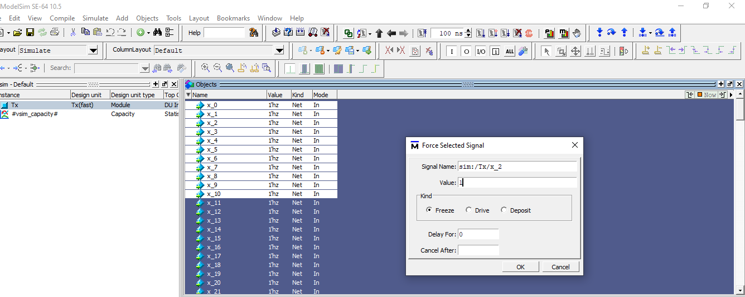
Input – Original Bits
Contd…

Slide 33
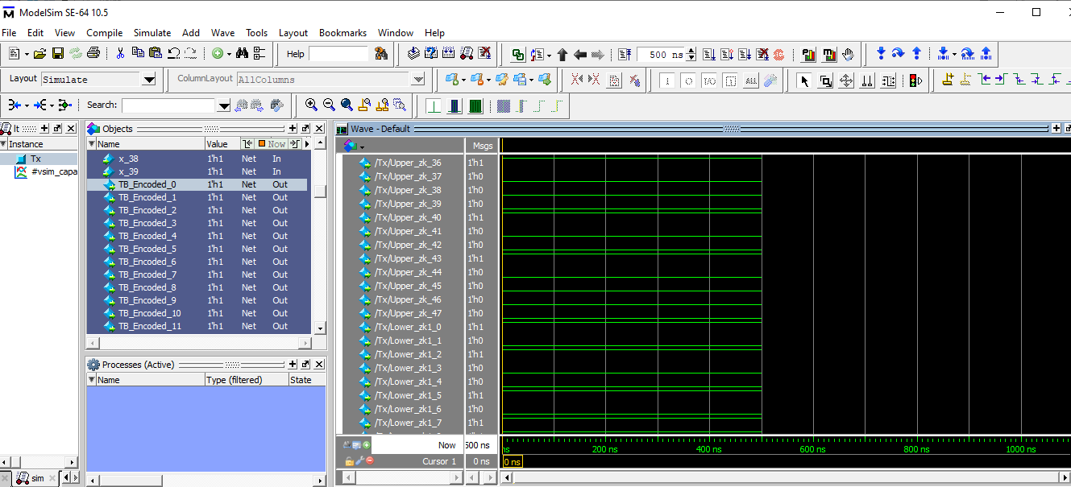
VERILOG – ENCODED OUTPUT

Slide 34
VERILOG CODE - RESULTS
Original Input:
x=[1 1 1 1 1 1 1 1 1 1 1 1 1 1 1 1 1 1 1 1 0 0 0 0 0 0 0 0 0 0 0 0 0 0 0 1 1 1 1 1 ]
Output of the Encoded Bits:
TB_Encoded=[1 1 1 1 1 1 1 1 1 1 1 1 1 1 1 1 1 1 1 1 0 0 0 0 0 0 0 0 0 0 0 0 0 0 0 1 1 1 1 1 0 0 1 1 0 0 0 0 ]
Lower_zk1=[1 0 1 0 0 1 0 1 1 1 1 1 1 0 1 0 0 1 0 1 1 0 0 0 1 1 0 0 0 1 1 1 0 0 1 0 0 0 0 1 0 0 0 1 0 0 0 0 ]
Upper_zk=[1 0 1 0 0 0 1 1 0 1 0 0 0 1 1 0 1 0 0 0 0 1 1 1 0 0 1 0 1 1 1 0 0 1 0 0 1 0 0 0 1 0 0 1 0 0 0 0 ]

Slide 35
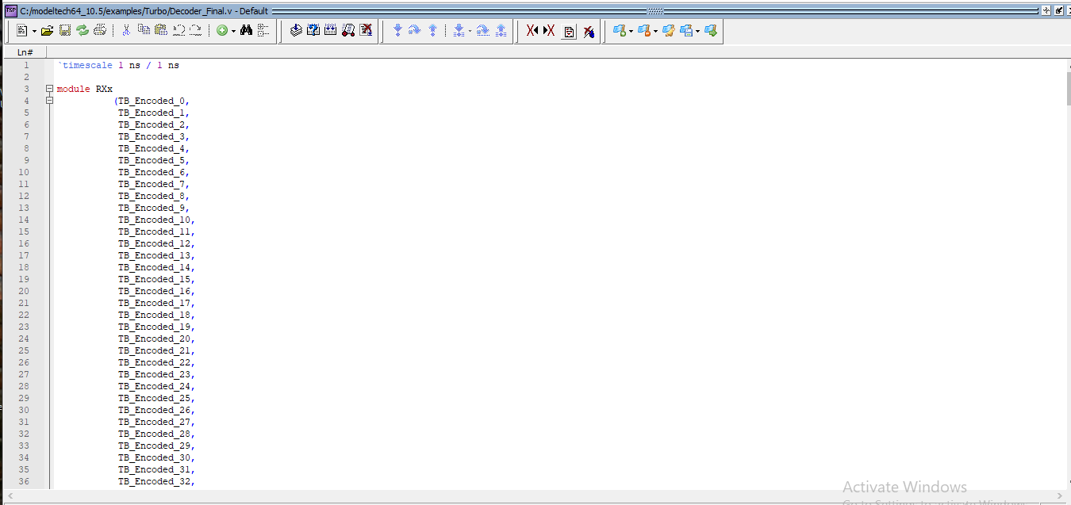
VERILOG CODE - DECODER
In decoder side, when the Encoded bits are given as input, the decoded output from the interleaver is generated and the simulation results are verified with the MATLAB results.
Contd…

Slide 36
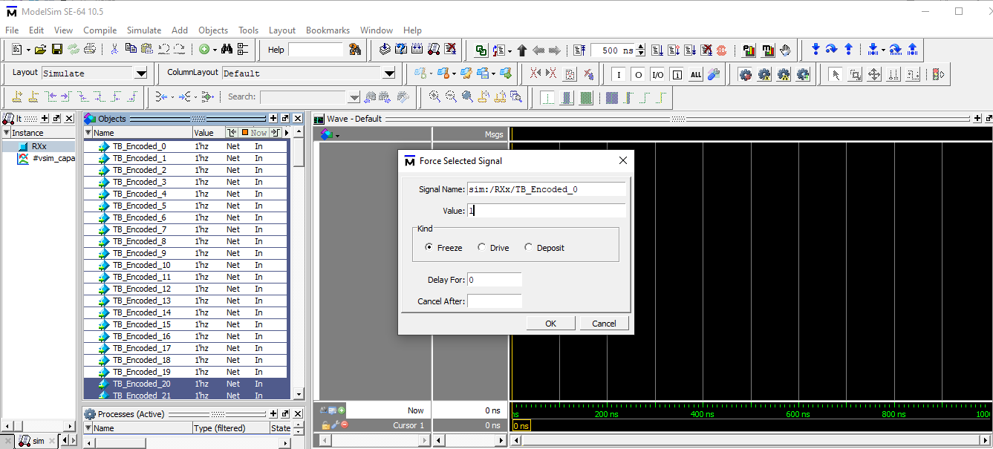
Input – Encoded Bits
Contd…

Slide 37
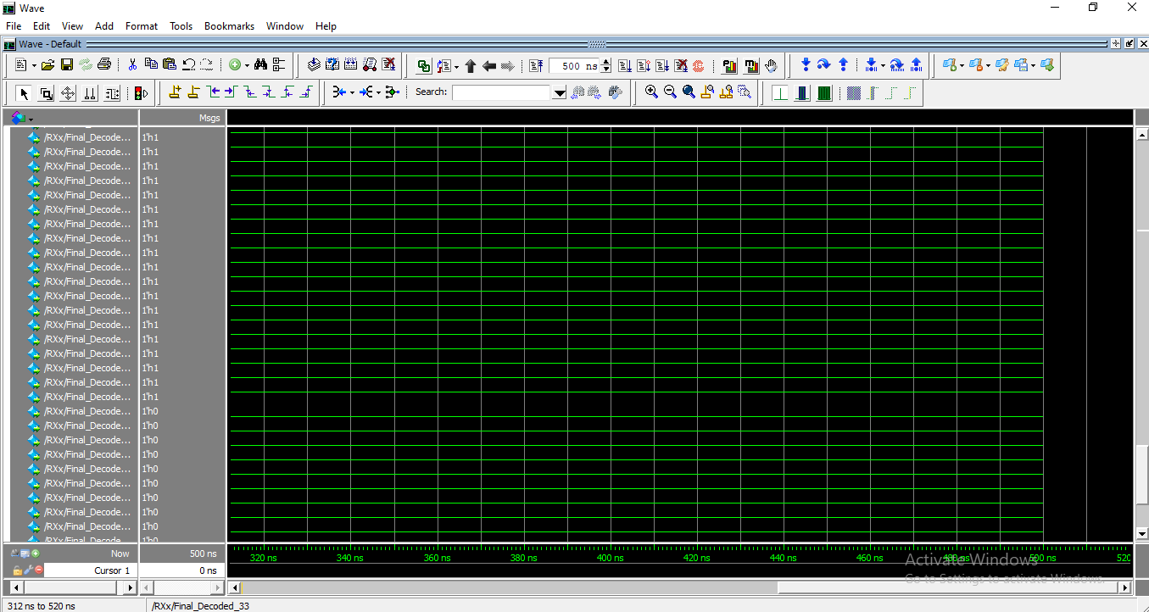
VERILOG – DECODED OUTPUT

Slide 38
VERILOG CODE - RESULTS
Input Encoded Bits:
TB_Encoded=[1 1 1 1 1 1 1 1 1 1 1 1 1 1 1 1 1 1 1 1 0 0 0 0 0 0 0 0 0 0 0 0 0 0 0 1 1 1 1 1 0 0 1 1 0 0 0 0 ]
Lower_zk1=[1 0 1 0 0 1 0 1 1 1 1 1 1 0 1 0 0 1 0 1 1 0 0 0 1 1 0 0 0 1 1 1 0 0 1 0 0 0 0 1 0 0 0 1 0 0 0 0 ]
Upper_zk=[1 0 1 0 0 0 1 1 0 1 0 0 0 1 1 0 1 0 0 0 0 1 1 1 0 0 1 0 1 1 1 0 0 1 0 0 1 0 0 0 1 0 0 1 0 0 0 0 ]
Output of the Decoded Bits:
Final_Decoded = [ 1 1 1 1 1 1 1 1 1 1 1 1 1 1 1 1 1 1 1 1 0 0 0 0 0 0 0 0 0 0 0 0 0 0 0 1 1 1 1 1]

Slide 39
MATLAB CODING
A pipelined architecture for turbo encoders and decoders is implemented in MATLAB, to explore and understand their performance and to cross-verify the output obtained using Verilog.
MATLAB provides system objects for implementing turbo encoders and decoders, which can be configured with parameters like trellis structure, interleaver indices, and output indices.

Slide 40
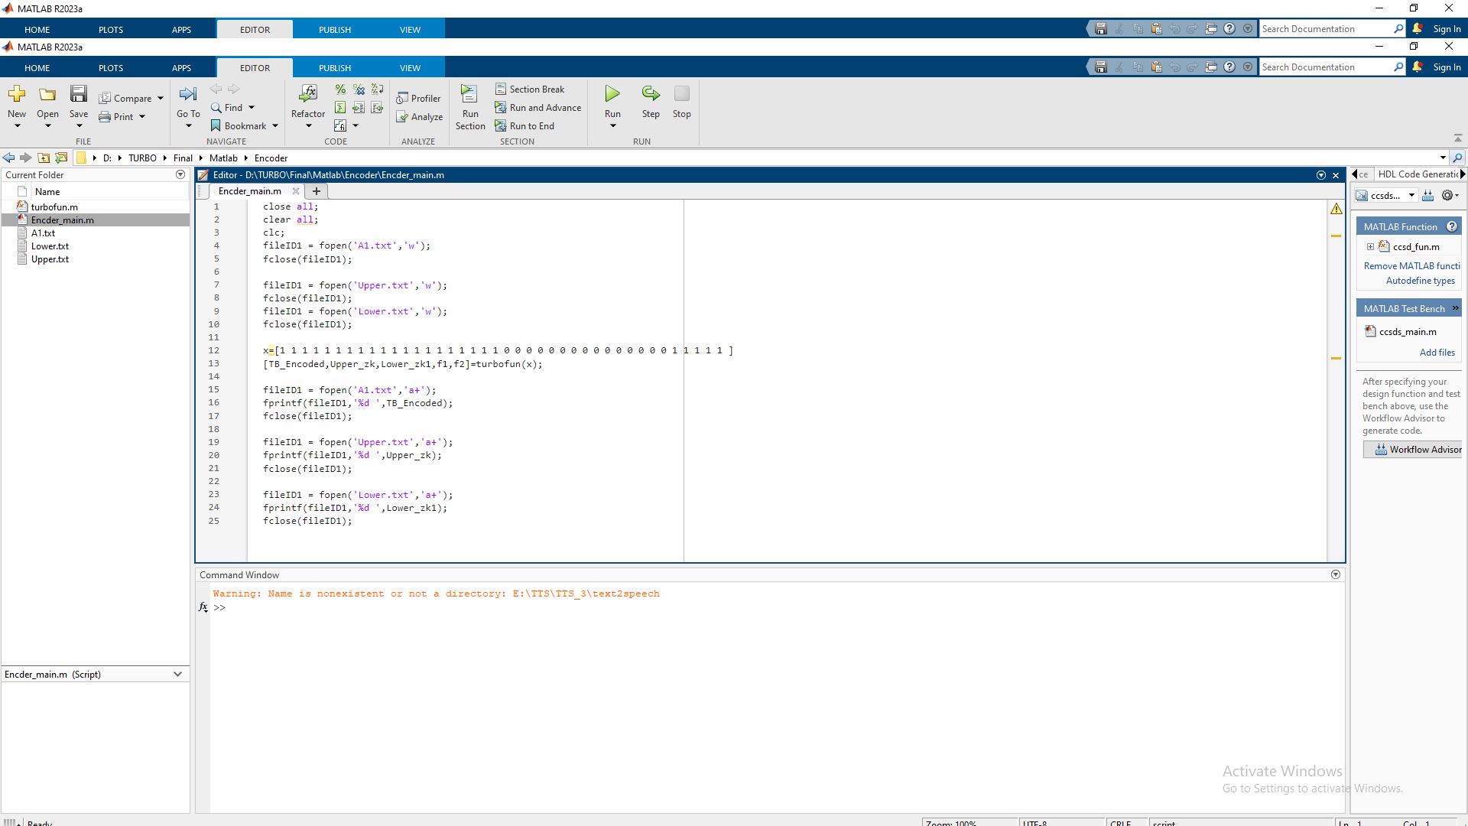
MATLAB CODE - ENCODER
Contd…

Slide 41
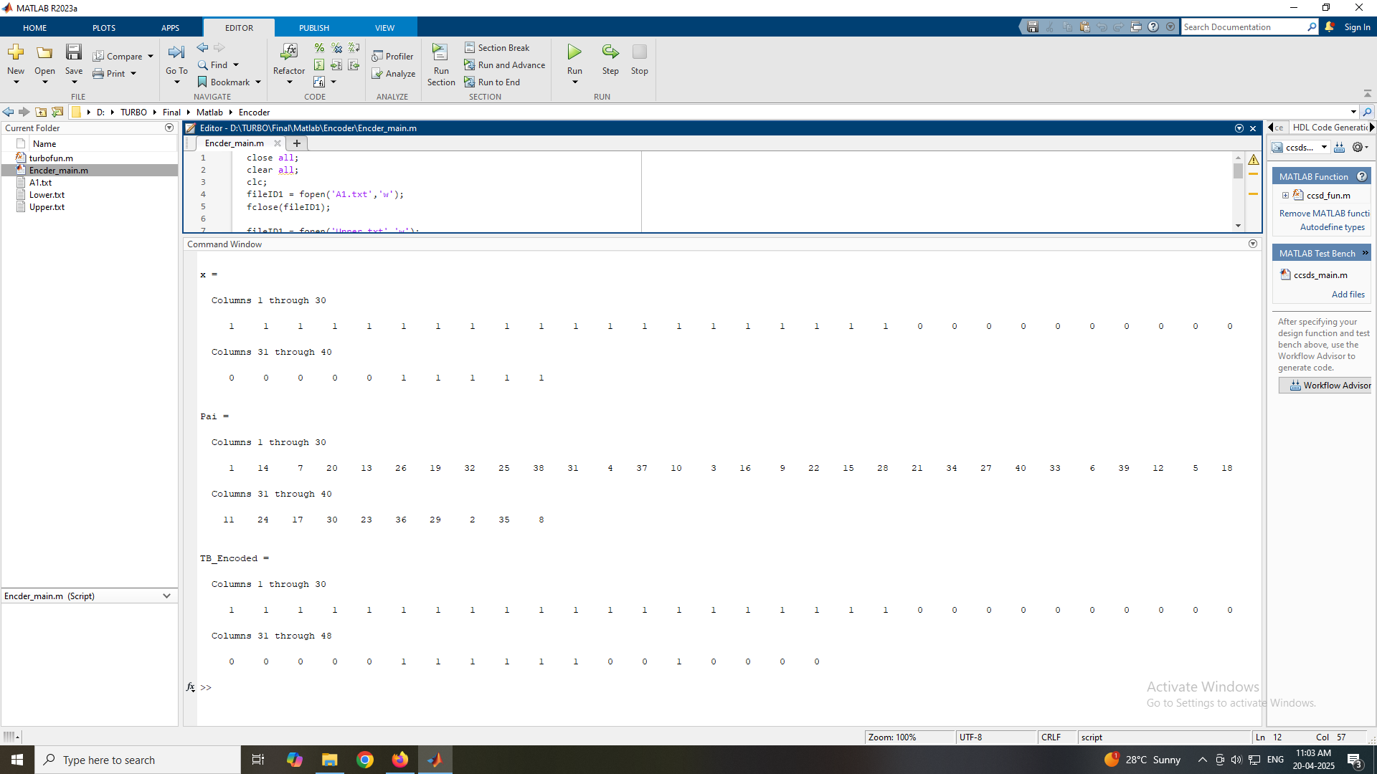
MATLAB – ENCODED OUTPUT

Slide 42
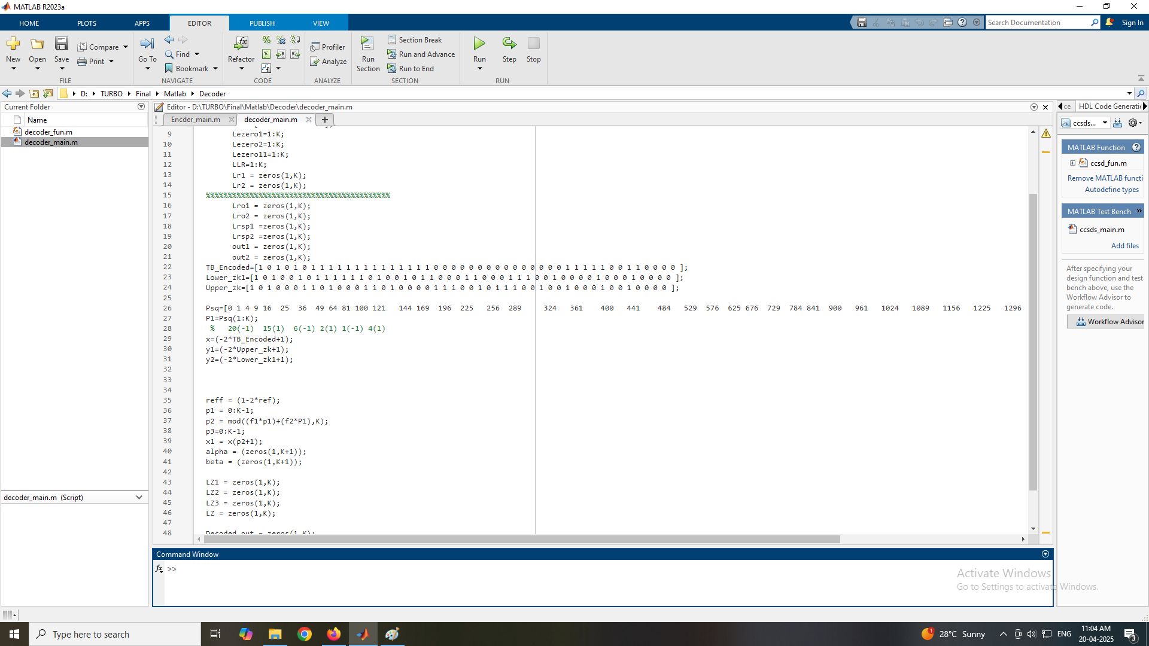
MATLAB CODE - DECODER
Contd…

Slide 43
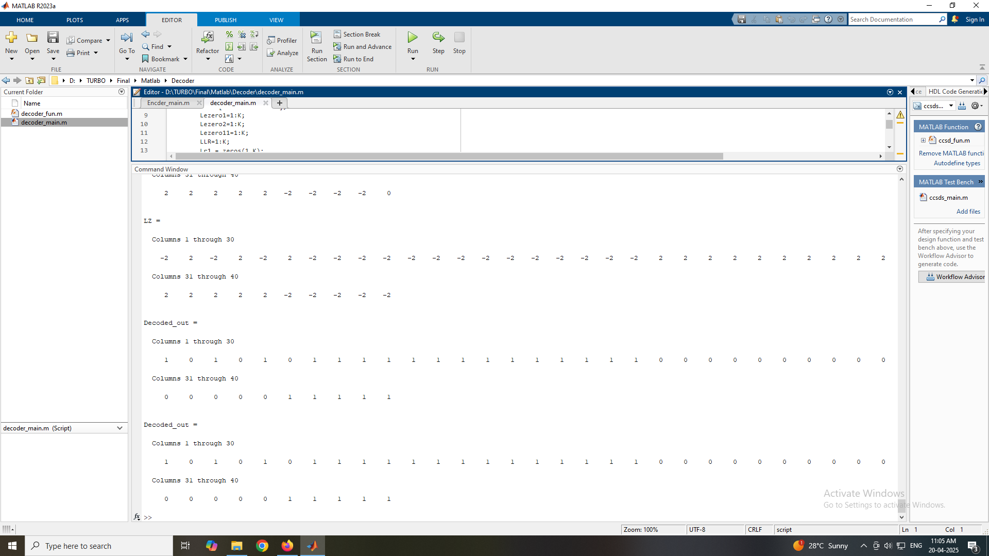
MATLAB – DECODED OUTPUT

Slide 44
CONCLUSION
Turbo codes are a powerful error-correcting coding scheme for use in wireless communication systems like 4G and 5G.
They consist of an encoder and a decoder, where the encoder adds redundancy to the data to make it more resilient to errors, and the decoder attempts to recover the original data from the corrupted received signal.
Pipelined turbo encoders and decoders, implemented in Verilog, offer a powerful solution for enhancing the performance of communication systems.
Contd…

Slide 45
CONCLUSION
By breaking down the encoding and decoding processes into stages, this architecture enables faster processing, higher throughput, and efficient resource utilization.
This makes it well-suited for applications requiring high-speed data transmission and real-time performance, such as 4G/5G networks.
The Results obtained through the simulation based on integer arithmetic simplifies the validation of results, showing that the results match the software simulation results and proving the effectiveness of the proposed architecture.

Slide 46
FUTURE SCOPE
In summary, a pipelined architecture in Verilog is a valuable approach for implementing turbo encoders and decoders, offering significant speed and throughput advantages for high-speed communication systems.
The future scope of this technology includes exploring new design strategies and integrating it with other advanced coding techniques.
Research areas include exploring different interleaver schemes, optimizing the pipeline structure for specific performance needs, and combining turbo codes with other error correction techniques.

Slide 47
REFERENCES
1."Design and analysis of turbo encoder using Xilinx ISE",By Palle Prasanth Kumar; K V Gowreesrinivas; P Samundiswary - in 2016 International Conference on Control, Instrumentation, Communication and Computational Technologies (ICCICCT)
2. "Turbo-Encoder Design for Symbol-Interleaved Parallel Concatenated Trellis-Coded Modulation", by Christina Fragouli, and Richard D. Wesel - in IEEE TRANSACTIONS ON COMMUNICATIONS, VOL. 49, NO. 3, MARCH 2018
3. "A Novel Turbo Codec Encoding and Decoding Mechanism", by Desai Feroz - in International Research Journal of Engineering and Technology (IRJET) e-ISSN: 2395-0056, Volume: 04 Issue: 10 | Oct -2017
4. "Designing & Analysis of Advanced Turbo Encoder and Decoder", by Pallavi D Hegu, Venkat Ghodke - in International Journal of Applied Research 2015; 1(8): 341-344

Slide 48
REFERENCES
5. C. Berrou and A. Glavieux, Turbo Codes. Hoboken, NJ, USA: Wiley, 2019.
6. Altera,"AN 505: 3GPP LTE Turbo Reference Design",AN-505-2.0,© January 2017
7. C. Berrou, A. Glavieux, and P. Thitimajshima, ‘‘Near Shannon limit error-correcting coding and decoding: Turbo-codes,’’ in Proc. IEEE Int. Conf. Commun. (ICC), Geneva, Switzerland, vol. 2, May 2021, pp. 1064–1070.
8. J. H. Gass, P. J. Curry, and C. J. Langford, ‘‘An application of turbo trellis coded modulation to
tactical communications,’’ in Proc. MILCOM. IEEE Mil. Commun. Conf., Oct. 1999, pp. 530–533.

Slide 49
THANK YOU

